Slide 1

Data Analysis
Mahmoud Gamiel

Slide 2

How we take any decision in our day-to-day life
Notes:
اول حاجه بتفكر الموقف ده اتكرر فبل كده ف حياتك او ف حياه دايره معارفك او جه موقف شبهه
-وبتفكر اي للي حصل
اللي خلى ده يحصل –
وعن طريق السوالين اللي فاتو تحاول تتنبأ باللي هيحصل –
ولو التنبؤ بتاعك قالك ان اللي هيحصل حاجه مش ف صالحك بتفكر ازاي ممكن اقلل الخساير او امنعها ولو اللي هيحصل ف صالحك ازا اخد اكبر مكسب -

Slide 3
AGENDA
01
02
03
04
Data Analysis
What is Data Analysis and main purpose of it ?
Types of Data Analysis
Data Analysis Process
Summary
Questions
Answers
05

Slide 4

What is Data Analysis and main purpose of it ?
Data analysis
Is defined as a process of cleaning, transforming, and modeling data to discover useful information for decision-making

Slide 5
What is Data Analysis and main purpose of it ?
Data analysis
Is defined as a process of cleaning, transforming, and modeling data to discover useful information for decision-making
The purpose of Data Analysis
is to extract useful information from data and taking the decision based upon the data analysis.

Slide 6

Types of Data Analysis
Descriptive Analysis
Diagnostic Analysis
Predictive Analysis
Perspective Analysis

Slide 7

Descriptive analysis
Q"What's happened“
EX:
1 - KPI Dashboards
2 - Monthly revenue reports
3 - Overview of potential clients

Slide 8
Descriptive analysis
Diagnostic analysis
Q"What's happened“
EX:
1 - KPI Dashboards
2 - Monthly revenue reports
3 - Overview of potential clients
Q“Why did it happened“
EX:
1-reson for increasing or decreasing revenue

Slide 9
Predictive analysis
Q" what is likely to happen“
EX:
1- Sales Forecasting
2- Using customer segmentation to determine which leads have the best chance of converting

Slide 10
Predictive analysis
Prescriptive analysis
Q" what is likely to happen“
EX:
1- Sales Forecasting
2- Using customer segmentation to determine which leads have the best chance of converting
Q “what should we do“
EX:
combining the insight from all previous analyses
And take the best decision

Slide 11
Data Analysis Process
Data Collection
Data Cleaning
Asking Question
Explanatory Analyses & Communicate Results
Understanding your Data & EDA

Slide 12
01
Data Collection
Where is the data coming from?

Slide 13
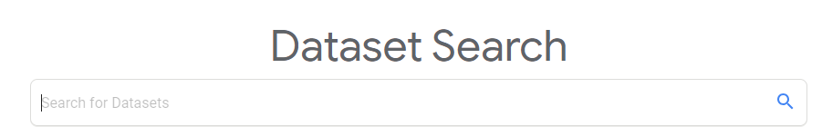




Slide 14


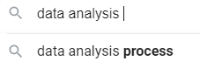


Data set types
Structured data set
CSV or Excel files
SQL databases
Unstructured data set
Text
Images
Audio

Slide 15
02
Data Cleaning
You will not be able to see the stars in a cloudy sky

Slide 16
Data Cleaning
Missing Values
Anomalies/Outliers
Incorrect Format
Incorrect Headers

Slide 17
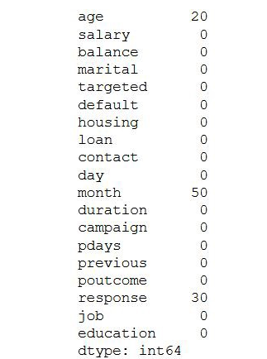
Missing Values
There are mainly three types of missing values.
Missing completely at random: These values do not depend on any other features.
Missing at random: These values may be dependent on some other features.
Missing not at random: These missing values have some reason for why they are missing.

Slide 18
How we can dealing with missing values
Fill with mean or median (numeric values ).
Fill with mode(none numeric values ).
Drop missing values from dataset or drop columns

Slide 19
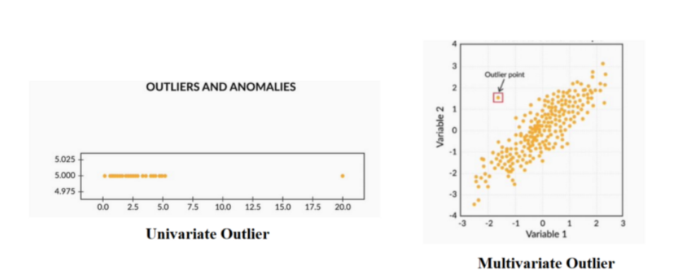
Handling Outliers
Outliers are the values that are far beyond the next nearest data points.
There are two types of outliers
Notes:
1-Univariate outliers: Univariate outliers are the data points whose values lie beyond the range of expected values based on one variable
2-Multivariate outliers: While plotting data, some values of one variable may not lie beyond the expected range, but when you plot the data with some other variable, these values may lie far from the expected value

Slide 20
03
ASKING QUESTIONS
Your Data Won’t Speak Unless You Ask It The Right Data Analysis Questions

Slide 21
—SOMEONE FAMOUS
“Data Is Only As Good As The Questions You Ask”

Slide 22

Talking With Data Genie
(You have only 3 questions )
OUR MISSION : How we can raise
more revenue in our business

Slide 23
Talking With Data Genie
(You have only 3 questions )
OUR MISSION : How we can raise
more revenue in our business
your questions to be extremely specific. The more specific it is, the more valuable (and actionable) the answer is going to be.

Slide 24
Talking With Data Genie
(You have only 3 questions )
OUR MISSION : How we can raise
more revenue in our business
your questions to be extremely specific. The more specific it is, the more valuable (and actionable) the answer is going to be.
So, instead of asking, “How can I raise revenue?”, you should ask: “What are the channels we should focus more on in order to raise revenue while not raising costs very much, leading to bigger profit margins?”. Or even better: “Which marketing campaign that I did this quarter got the best ROI, and how can I replicate its success?”

Slide 25
04
UNDERSTANDING YOUR DATA
IT’S GOOD JOURNEY IF YOU GETTING READY
Notes:
If we want to explain EDA in simple terms, it means trying to understand the given data much better, so that we can make some sense out of it.

Slide 26

Landing on the Island Of The Data

Slide 27

In the morning hard working & exploring
Dealing With Data Frames
& statistical methods

Slide 28
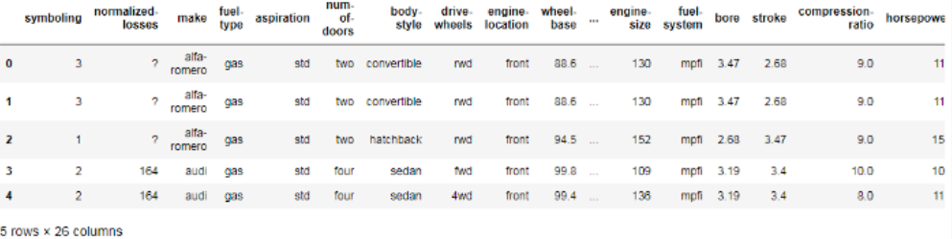
1. Dealing with Data frame
1.0.Show a head from your data frame

Slide 29
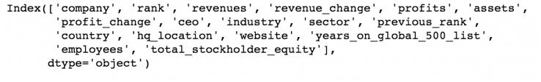
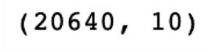
1.1.Show a name of columns
1.2.Show the shape of my data frame

Slide 30
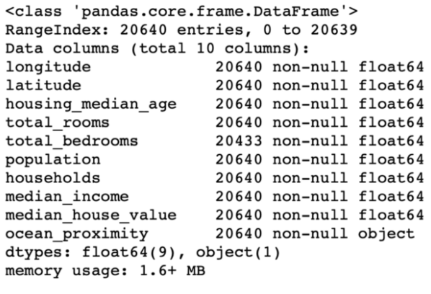
1.3.Show info about your data

Slide 31
1.3.Show info about your data

Slide 32
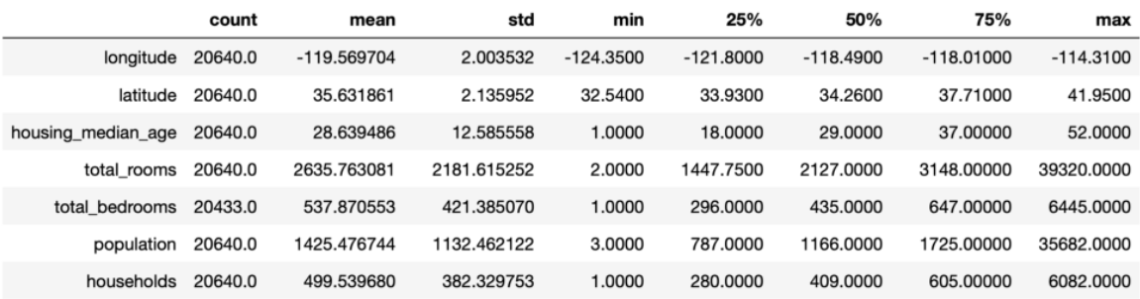
1.4.Describe your data (statistical tool)

Slide 33
In the night Go deeper , dealing with features
& Visualization
In this stage Exploratory Data we’ll see about the following topics:
-Univariate analysis
-Bivariate analysis
-Multivariate analysis

Slide 34
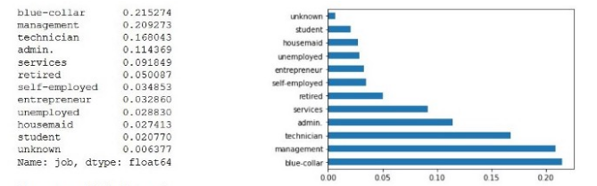
Univariate Analysis
If we analyze data over a single variable/column from a dataset, it is known as Univariate Analysis.

Slide 35
Bivariate Analysis
If we analyze data by taking two variables/columns into consideration from a dataset, it is known as Bivariate Analysis.
a) Numeric-Numeric Analysis:
Analyzing the two numeric variables from a dataset is known as numeric-numeric analysis. We can analyze it in three different ways.
Scatter Plot
Pair Plot
Correlation Matrix

Slide 36
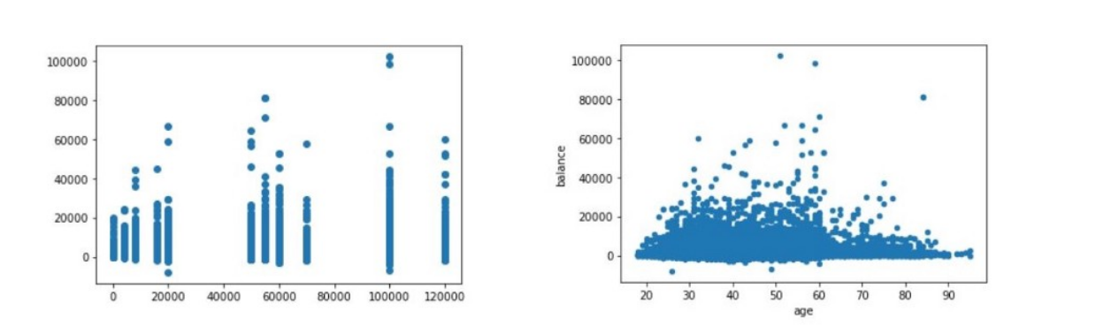
Scatter Plot

Slide 37
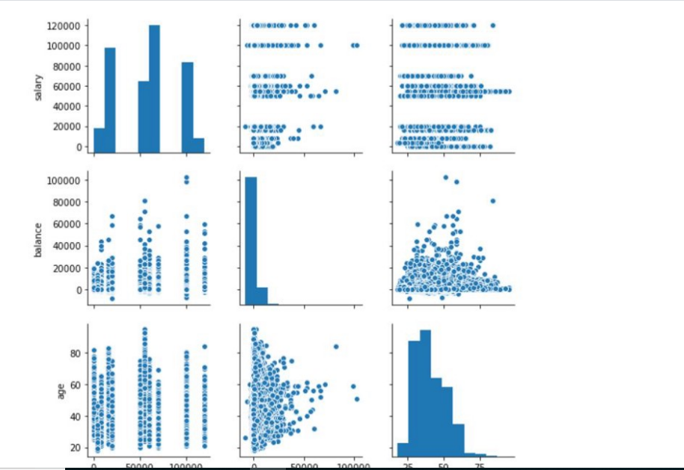
Pair Plot
Now, let’s plot Pair Plots for the three columns we used in plotting
Scatter plots

Slide 38
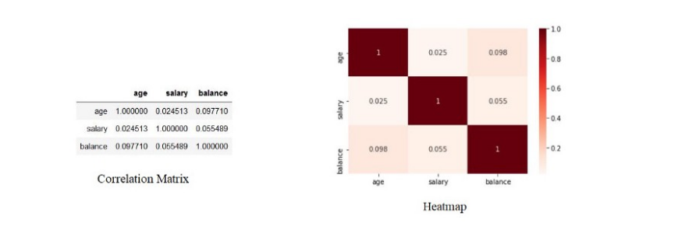
Correlation Matrix
Since we cannot use more than two variables as x-axis and y-axis in Scatter and Pair Plots, it is difficult to see the relation between three numerical variables in a single graph. In those cases, we’ll use the correlation matrix

Slide 39
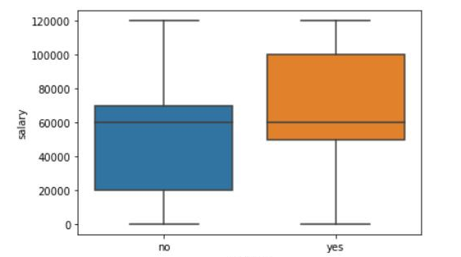
b) Numeric - Categorical Analysis
Analyzing the one numeric variable and one categorical variable from a dataset is known as numeric-categorical analysis. We analyze them mainly using mean, median, and box plots.
The box plot looks like this,

Slide 40
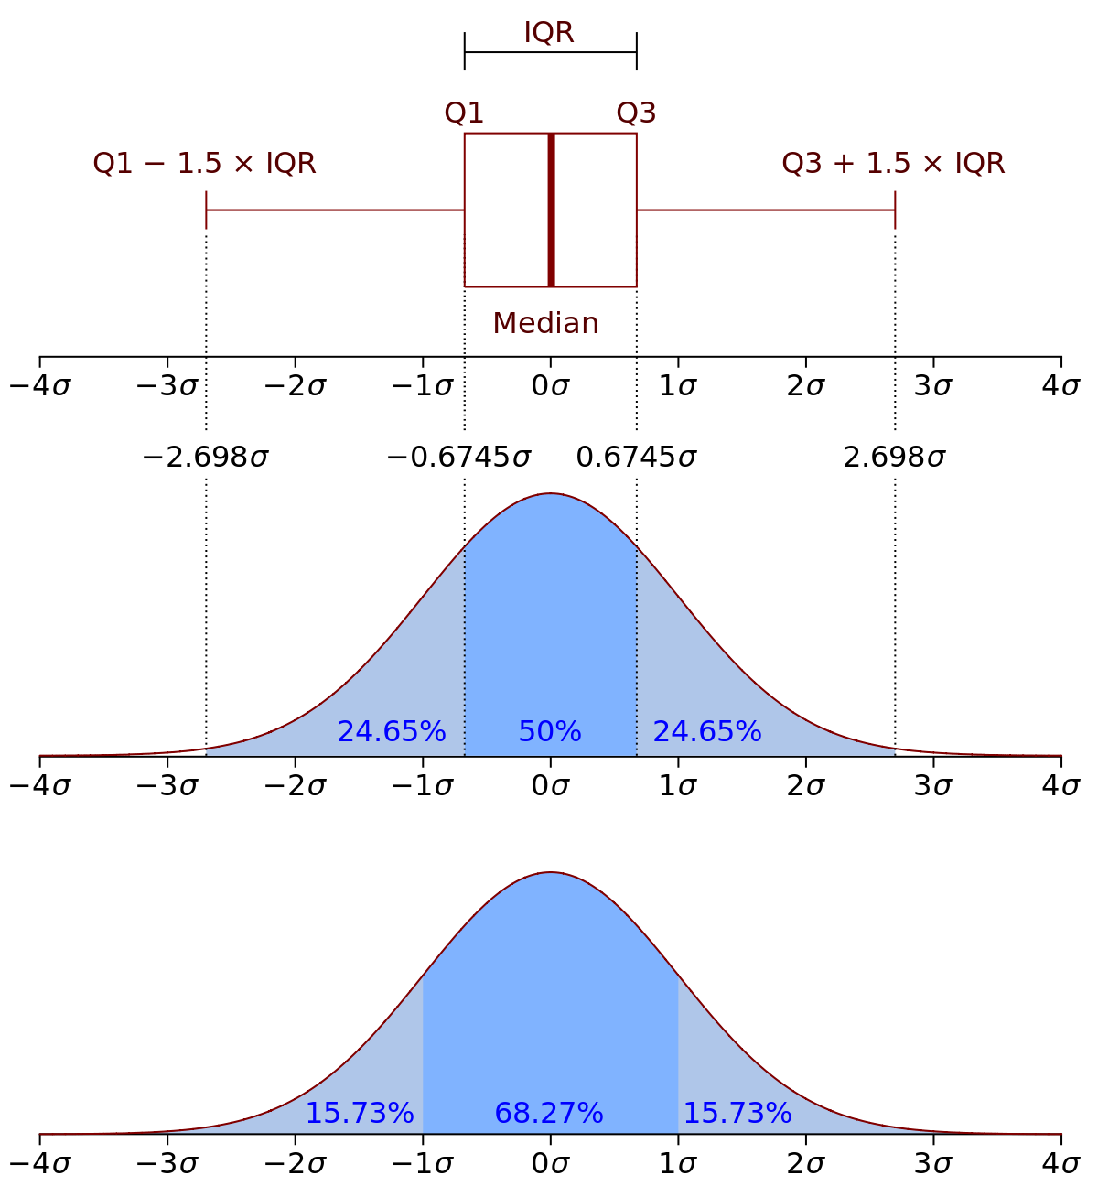

Slide 41
5. Multivariate Analysis
If we analyze data by taking more than two variables/columns into consideration from a dataset, it is known as Multivariate Analysis.

Slide 42
RAID SUMMARY
Types of data analysis
Data analysis
Descriptive Analysis
Diagnostic Analysis
Predictive Analysis
Prescriptive Analysis
Data analysis means a process of cleaning, transforming and modeling data to discover useful information for business decision-making
Data Analysis Process
Data Requirement Gathering, Data Collection, Data Cleaning, Data Analysis, Data Interpretation, Data Visualization

Slide 43
Explanatory & Exploratory Data Analytics
Do That For Us
Do That For audience
Notes:
Exploratory analysis :Here we get familiar with data,
ask questions, visualize the data in a number of forms,
look for relationships between the variables,
look for outliers, patterns and trends in data.
The output of exploratory analysis is usually only for the us, the data analysts.
Explanatory analytics : analysis is what happens when you have something specific you want to show an audience - probably

Slide 44
Communicate Your Results
It is important to share what you have learned with others. Scientists often find solutions to problems by knowing the results of other scientists' experiments. Communicating your results is often the first step to clearly identifying a problem and beginning to think about possible solutions

Slide 45

Describe Your Results What did you learn after looking at all the data? What summary statement can you make describing what you found?
.

Slide 46

Possible Explanations
Can you think of anything that may explain your results? Are there any factors that might change your results? How might you go about confirming your results? What, if anything, should be done by you or others based on your findings?

